Slide 1
This slide is hidden.
Insert the starting slides after this slide

Slide 2
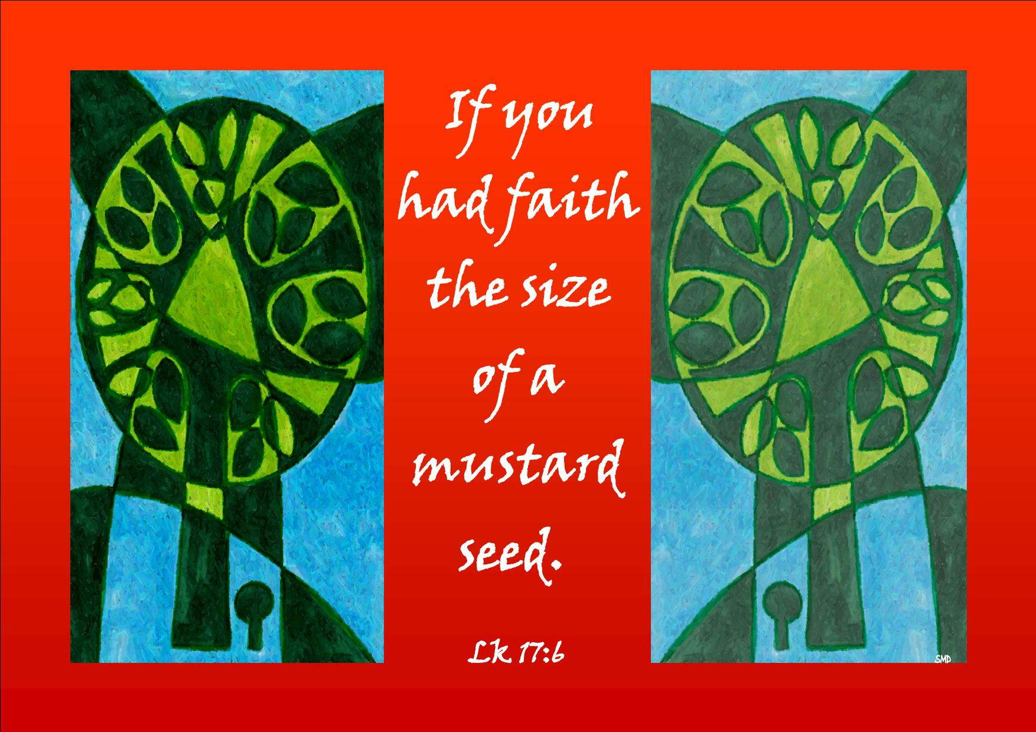
Welcome to St Michael’s
27th Sunday in Ordinary Time Year C
Please ensure all mobile phones are switched off.
Please be respectfully quiet as we prepare for our Celebration.
Notes:
Saturday 5.30PM First Sunday of Advent
7am - 22nd Sunday in Ordinary Time

Slide 3
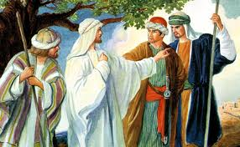
The apostles said to the Lord, ‘Increase our faith.’

Slide 4

The Lord replied, ‘Were your faith the size of a mustard seed …

Slide 5
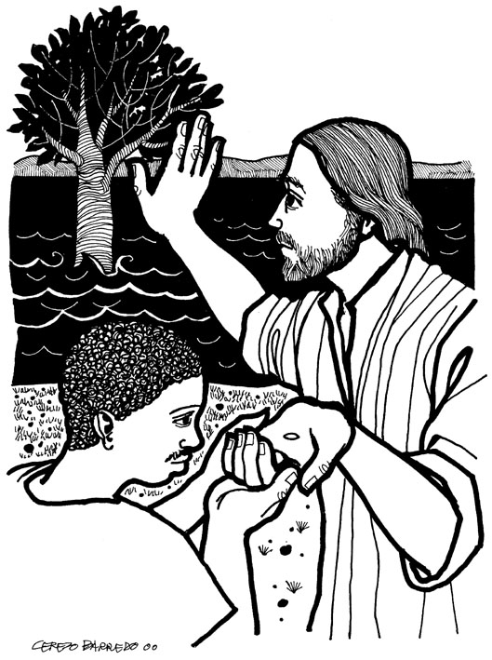
… you could say to this mulberry tree, “Be uprooted and planted in the sea,” and it would obey you.

Slide 6
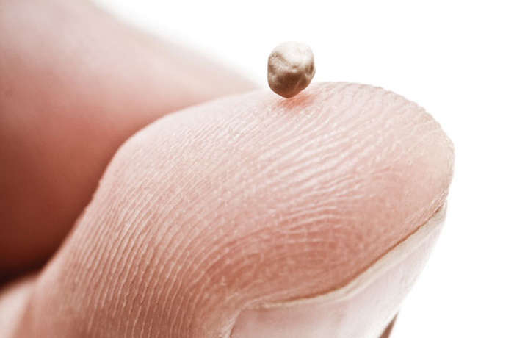
What are some challenges I currently face that call me to greater faith?

Slide 7
Please Stand

Slide 8
This slide is hidden.
Insert the Entrance Hymn after this slide

Slide 9
I will call upon the Lord
I will call upon the Lord
Who is worthy to be praised
So shall I be saved from my enemies
I will call upon the Lord

Slide 10
The Lord liveth, and blessed be the rock
Let the God of my salvation be exalted.
The Lord liveth and blessed be the rock
Let the God of my salvation be exalted.

Slide 11
I will call upon the Lord
Who is worthy to be praised
So shall I be saved from my enemies
I will call upon the Lord

Slide 12
The Lord liveth, and blessed be the rock
Let the God of my salvation be exalted.
The Lord liveth and blessed be the rock
Let the God of my salvation be exalted.

Slide 14
Confiteor
I confess to almighty God
And to you, my brothers and sisters,
That I have greatly sinned
In my thoughts and in my words

Slide 15
In what I have done
And in what I have failed to do,
Through my fault,
Through my fault,
Through my most grievous fault;

Slide 16
Therefore I ask blessed Mary ever-Virgin,
All the Angels and Saints,
And you, my brothers and sisters,
To pray for me to the Lord our God.

Slide 18
Kyrie eleison
Kyrie eleison (2)
Christe eleison (2)
Kyrie eleison (2)

Slide 20
Glory to God
Glory to God in the highest,
And on earth peace to people of good will.
We praise you, we bless you,
We adore you, we glorify you

Slide 21
We give you thanks for your great glory,
Lord God heavenly King,
O God, almighty Father

Slide 22
Lord Jesus Christ, only begotten Son,
Lord God, Lamb of God,
Son of the Father,

Slide 23
You take away the sins of the world,
Have mercy on us;
You take away the sins of the world,
Receive our prayer;

Slide 24
You are seated
At the right hand of the Father
Have mercy on us

Slide 25
For you alone are the Holy One,
You alone are the Lord
You alone are the most High,
Jesus Christ

Slide 26
With the Holy Spirit,
In the glory of God the Father.
Amen!
Amen!

Slide 27
Gloria
Glory to God in the highest,
and on earth peace to people of good will.
We praise you, we bless you,
we adore you, we glorify you,

Slide 28
We give you thanks for your great glory,
Lord, God heavenly king,
O God, almighty father

Slide 29
Glory to God in the highest,
and on earth peace to people of good will.

Slide 30
Lord Jesus Christ, Only Begotten Son,
Lord God, Lamb of God, Son of the Father,
you take away the sins of the world,
have mercy on us;

Slide 31
you take away the sins of the world, receive our prayer;
you are seated at the right hand of the Father,
have mercy on us.

Slide 32
Glory to God in the highest,
and on earth peace to people of good will.

Slide 33
For you alone are the Holy One,
you alone are the Lord,
you alone are the Most High, Jesus Christ,
with the Holy Spirit,
in the glory of God the Father.

Slide 34
Glory to God in the highest,
and on earth peace to people of good will.
Amen.

Slide 36
Responsorial Psalm
If today you hear his voice,
harden not your hearts

Slide 38
Alleluia
Alleluia, alleluia,
alleluia, alleluia

Slide 39
Alleluia
Alleluia, alleluia,
alleluia, alleluia
Alleluia, alleluia,
Alleluia alleluia.

Slide 41
Apostles Creed
I believe in God,
the Father almighty,
Creator of heaven and earth,
and in Jesus Christ, his only Son, our Lord,
(At the words that follow, up to and including the Virgin Mary, all bow.)

Slide 42
who was conceived by the Holy Spirit,
born of the Virgin Mary,
suffered under Pontius Pilate,
was crucified, died and was buried;
he descended into hell;

Slide 43
on the third day he rose again from the dead;
he ascended into heaven,
and is seated at the right hand of God the Father almighty;

Slide 44
from there he will come to judge the living and the dead.
I believe in the Holy Spirit,
the holy catholic Church,

Slide 45
the communion of saints,
the forgiveness of sins,
the resurrection of the body,
and life everlasting.
Amen.

Slide 47
First Collection
This collection goes to the Bishop
for the support of the Diocese.
Thank you for your contribution

Slide 49
This slide is hidden.
Insert the Offertory Hymn after this slide.

Slide 50
Blessed be God
Blessed are you Lord God or all creation
Thanks to your goodness this bread we offer
Fruit of the earth, work of our hands
It will become the bread of life

Slide 51
Blessed be God, blessed be God
Blessed be God forever amen.
Blessed be God, blessed be God
Blessed be God forever amen

Slide 52
Blessed are you Lord, God of all creation
Thanks to your goodness this wine we offer
Fruit of the vine, work of our hands
It will become the cup of joy

Slide 53
Blessed be God, blessed be God
Blessed be God forever amen.
Blessed be God, blessed be God
Blessed be God forever amen

Slide 55
Priest: Pray my brothers and sisters,
that my sacrifice and yours may be
acceptable to God, the almighty Father.
All: May the Lord accept the sacrifice
at your hands for the praise and glory of his name, for our good and the good of all his holy Church.

Slide 56
Priest: The Lord be with you.
All: And with your spirit.
Priest: Lift up your hearts.
All: We lift them up to the Lord.

Slide 57
Priest: Let us give thanks to the
Lord our God.
All: It is right and just.

Slide 59
Holy
Holy, Holy, Holy Lord God of hosts,
Heaven and earth are full of your glory. Hosanna in the highest
Blessed is he who comes
in the name of Lord,
Hosanna in the highest.

Slide 61
Memorial acclamation
Save us saviour of the world,
For by your cross and resurrection,
You have set us free

Slide 62
Memorial acclamation
When we eat this bread
And drink this cup
We proclaim your death O Lord
Until you come again

Slide 63
Memorial acclamation
We proclaim your death O Lord
And profess your resurrection
Until you come again

Slide 65
Amen
Amen, amen, amen, amen.
Amen, amen, amen, amen.

Slide 66
Amen
Amen! Amen!
Amen! Amen!

Slide 68
Priest: The Lord be with you.
All: And with your spirit

Slide 70
Peace
May the peace of the Lord be with you
With your friends and your family too
Let it be, let it grow
And everywhere you go
May the peace of the Lord follow you

Slide 71
Lamb of God
Lamb of God,
You take away the sins of the world
Have mercy on us

Slide 72
Lamb of God,
You take away the sins of the world
Have mercy on us

Slide 73
Lamb of God,
You take away the sins of the world
Grant us peace

Slide 74
Lamb of God
Lamb of God, lamb of God
You take away the sins of the world
Have mercy on us, lamb of God

Slide 75
Lamb of God, lamb of God
You take away the sins of the world
Have mercy on us, lamb of God

Slide 76
Lamb of God, lamb of God
You take away the sins of the world
Grant us, grant us peace

Slide 78
All: Lord, I am not worthy
that you should enter under my roof,
but only say the word
and my soul shall be healed.

Slide 80
Priest: Behold the Lamb of God, behold him
who takes away the sins of the world.
Blessed are those called to the supper of the Lamb.
All: Lord, I am not worthy
that you should enter under my roof,
but only say the word
and my soul shall be healed.

Slide 81
This slide is hidden.
Insert the Communion Hymns after this slide.

Slide 83
Come to the table
Come to the table of the Lord, my friend.
Come to the altar of his love.
Bring him your cloudy doubts and fears,
my friend,
Bring him the storms within your heart.

Slide 84
See all the beauty he has made for us,
See how the Lord has set us free
He lived and died
for you and me my friend,
He comes to us again today

Slide 85
Come to the table of the Lord, my friend.
Come to the altar of his love.
Bring him your cloudy doubts and fears,
my friend,
Bring him the storms within your heart.

Slide 86
Take and eat
Take and Eat, Take and Eat,
This is my body given up for you.
Take and drink, Take and drink,
This is my blood given up for you.

Slide 87
I am the Word that spoke
and light was made;
I am the seed that died to be reborn;
I am the bread that comes
from heaven above;
I am the vine that fills
your cup with joy.

Slide 88
Take and Eat, Take and Eat,
This is my body given up for you.
Take and drink, Take and drink,
This is my blood given up for you.

Slide 89
I am the Lamb that takes away your sin;
I am the gate that
guards you night and day.
You are my flock; you know the shepherd’s voice. You are my own;
your ransom is my blood

Slide 90
Take and Eat, Take and Eat,
This is my body given up for you.
Take and drink, Take and drink,
This is my blood given up for you.

Slide 91
I am the cornerstone that God has laid,
A chosen stone and precious in his eyes.
You are God’s dwelling place;
on me you rest,
Like living stones, a temple for God’s praise.

Slide 92
Take and Eat, Take and Eat,
This is my body given up for you.
Take and drink, Take and drink,
This is my blood given up for you.

Slide 93
I Will Pilot Thee
Sometimes when my faith would falter
And no sunlight I can see
I just lift mine eyes to Jesus
And I whisper ‘pilot me’

Slide 94
“Fear thou not for I’ll be with thee,
I will still they pilot be,
Never mind the tossing billows,
Take my hand and trust in me”

Slide 95
Often, when my soul is weary
And the day seems oh so long
I just look up to my pilot
And iI hear this blessed song,

Slide 96
“fear thou not for I’ll be with thee,
I will still they pilot be,
Never mind the tossing billows,
Take my hand and trust in me”

Slide 97
When temptations ‘round me gather
And I almost loose my way
Somehow, in the raging tempest,
I can hear my saviour say.

Slide 98
“fear thou not for I’ll be with thee,
I will still they pilot be,
Never mind the tossing billows,
Take my hand and trust in me”

Slide 99
Second Collection
What you contribute now
is for the support of our
parish and its mission.
Thank you for your generosity

Slide 100
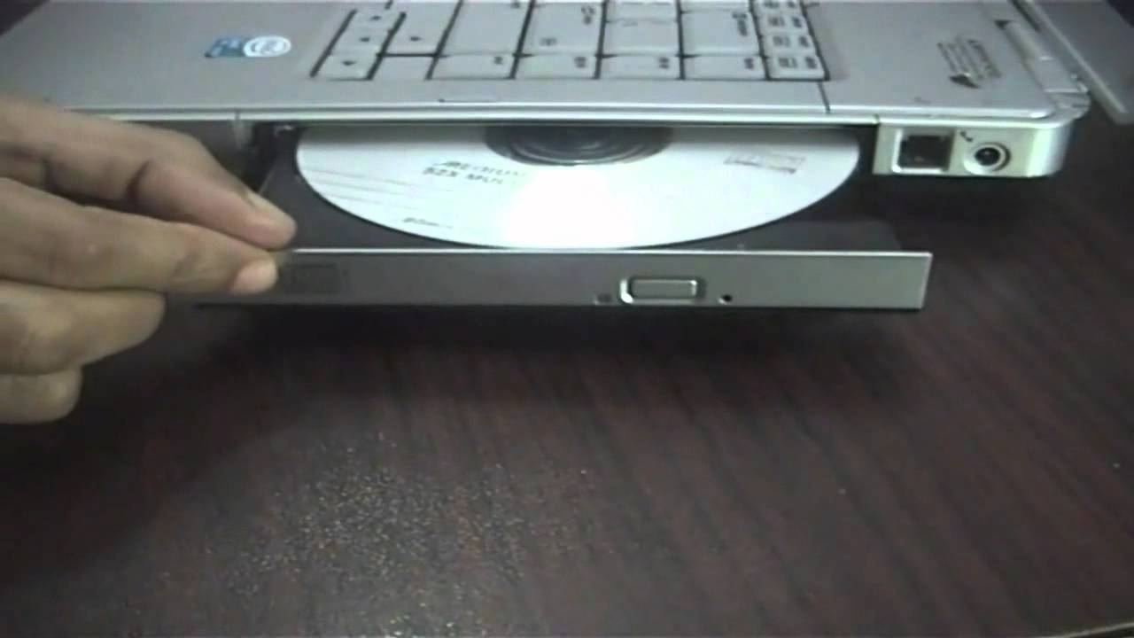
Helpers for non-choir Masses to operate DVD and computer
7th October, 7pm
Notes:
Volunteers willing to use the computer during Mass to display powerpoint and DVD are invited to attend an information evening on the 7th October 7pm. Contact Paul Scott or just turn up on the night.

Slide 101
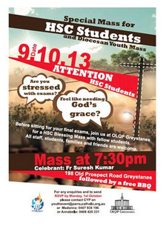

Slide 102

eConference: Gospel of John
Wednesday 16 October
Institute for Mission Blacktown
10:00am – 3:00pm
Tea/Coffee provided
Bring your own lunch!
Bookings
mh@instituteformission.com.au
9831 4911

Slide 103

BLACKTOWN-MT DRUITT- HANDS AND VOICES!
A Sydney Alliance Discernment Assembly hosted by
the Tongan Community of Blacktown Uniting Church
59-65 Bungarribee Road, Blacktown
SUN 13th OCT 2013
2.00pm – 4.00pm

Slide 104

The SVDP pantry needs to restock the following items:
Long life milk, Biscuits, 2 min noodles, Cereal and Baked Beans
Many thanks for your support

Slide 105

Please take home your bulletins or download it from
www.stmichaelsparish.com
  www.facebook.com/
  blacktowncatholics

Slide 106
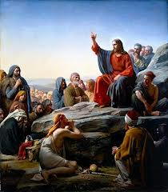
We invite all HSC Students to the Altar
for a Special Blessing

Slide 107
Student Blessing
Heavenly father we call down your blessing on these students as they prepare to sit their final school examinations. Be with them as they prepare, experience and complete each of their exams, grant them wisdom and knowledge of your Holy Spirit.

Slide 108
Student Blessing
Jesus our friend and companion, journey with our Year 12 students, comforting them in times of stress, celebrating with them in their successes and holding them close always.
Amen

Slide 109
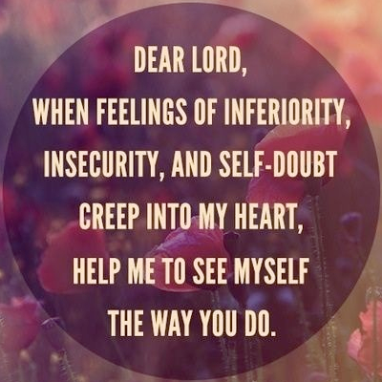
HSC STUDENTS PRAYER RECITE TOGETHER

Slide 110
This slide is hidden.
Insert the Notices for the week after this slide

Slide 111
This slide is hidden.
The next slide can be used for videos.
Insert the video into the slide.

Slide 113
Priest: The Lord be with you.
All: And with your spirit.

Slide 115
This slide is hidden.
Insert the Recessional Hymns after this slide.

Slide 116
This little light of mine
This little light of mine,
I’m gonna let it shine (3)
Let it shine , let it shine, let it shine.

Slide 117
The light that shines is the light of love,
It lights the darkness from above,
It shines on me and it shines on you
And shows what the power of love can do

Slide 118
I’m gonna shine my light both far and near,
Shine my light both bright and clear,
Where there’s a dark corner in this land,
I’m gonna let my little light shine.

Slide 119
This little light of mine,
I’m gonna let it shine (3)
Let it shine , let it shine, let it shine.

Slide 120
What are some challenges I currently face that call me to greater faith?

Slide 121
This slide is hidden.
Insert the final slide here.

